Slide 1

Year 2 2025-6 curriculum information Meeting

Slide 2
What will be covered?
The Year 2 Team
Curriculum
Celebration
Home Learning
Communication
Notes:
Mel

Slide 3
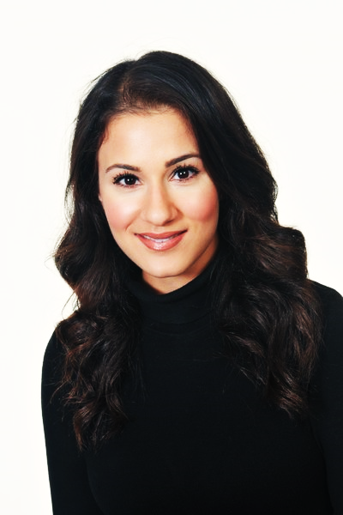
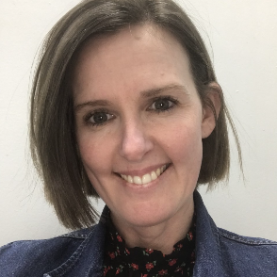
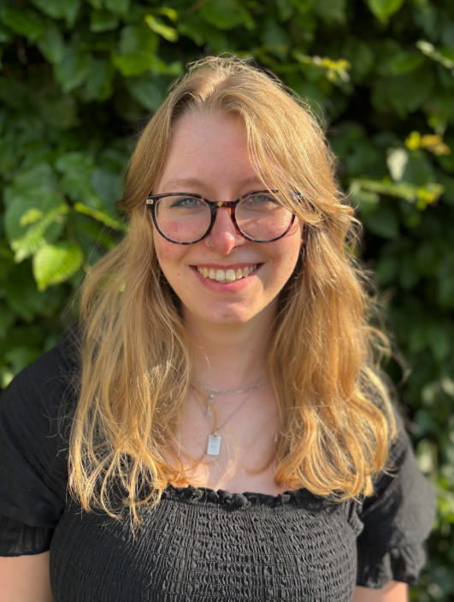



The Year 2 Team
Mrs Hyams
Vole Class and
Year 2 Lead
Mrs Hosken
Squirrel Class
Miss Cunnington
Rabbit Class
Notes:
Mel

Slide 4
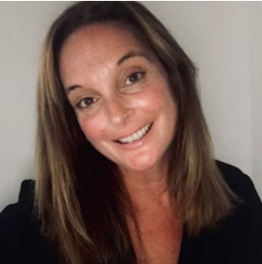
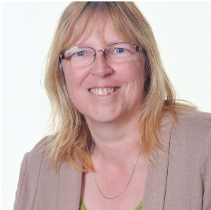
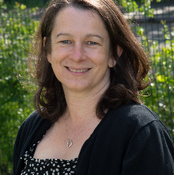
The Year 2 Team
Mrs Rosling
3 days
Mrs Hewitt
5 afternoons
Mrs Robinson
4 mornings
Notes:
Mel

Slide 5

A Typical Day
Register
Assembly
English
Break
Phonics
Maths
Lunch (lunchtime clubs)
Register
Science/Computing
Art/Life Learning/RE
History/ Geography
Notes:
Madi

Slide 6
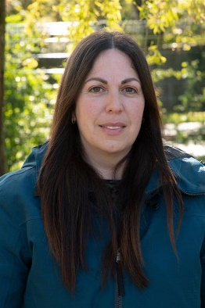
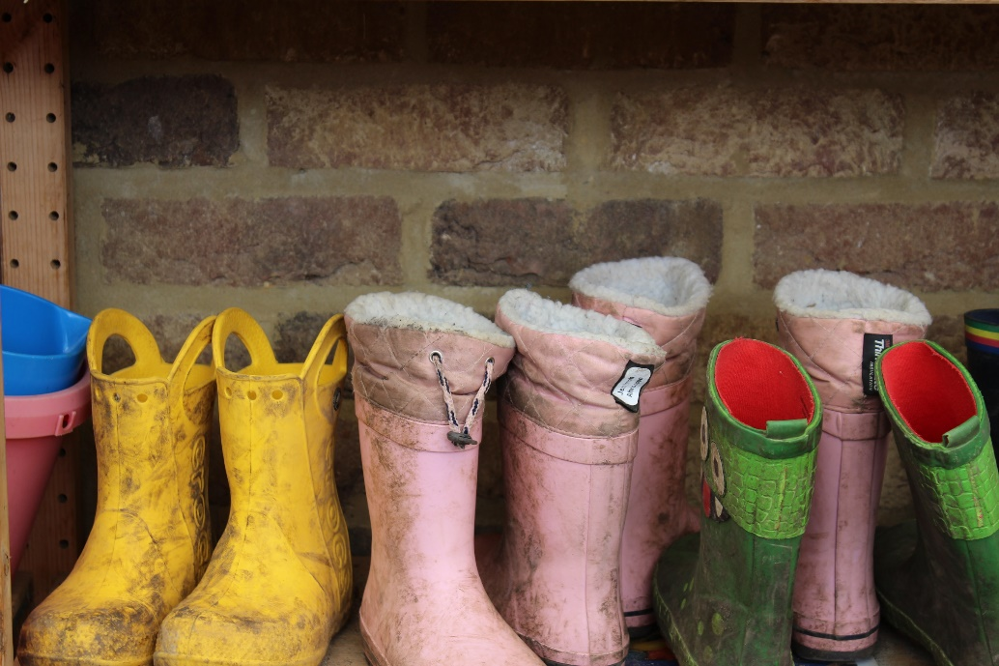
Forest School
Each Year 2 class will have 1 hour weekly sessions led by Miss Thomas.
Children will need to wear wellington boots, all in one rain suit these should be placed ideally in a blue drawstring bag and will remain in school.
Monday- Squirrel and Vole Class
Tuesday- Rabbit Class
Notes:
Madi

Slide 7

Uniform
Please ensure your child is wearing the correct uniform that follows the school policy and that all items are labelled. Children in Year 2 should still bring a book bag to school and only have one key-ring on them.
Standard analogue watches are permitted from Year 2 upwards. No smartwatches or digital watches are permitted at school.
One small, plain, stud earring in each earlobe is permitted. Children will need to be able to remove these themselves for all P.E. sessions. However, if you wish your child to continue wearing their earrings during PE then you will need to complete a disclaimer form.
Notes:
Mel

Slide 8
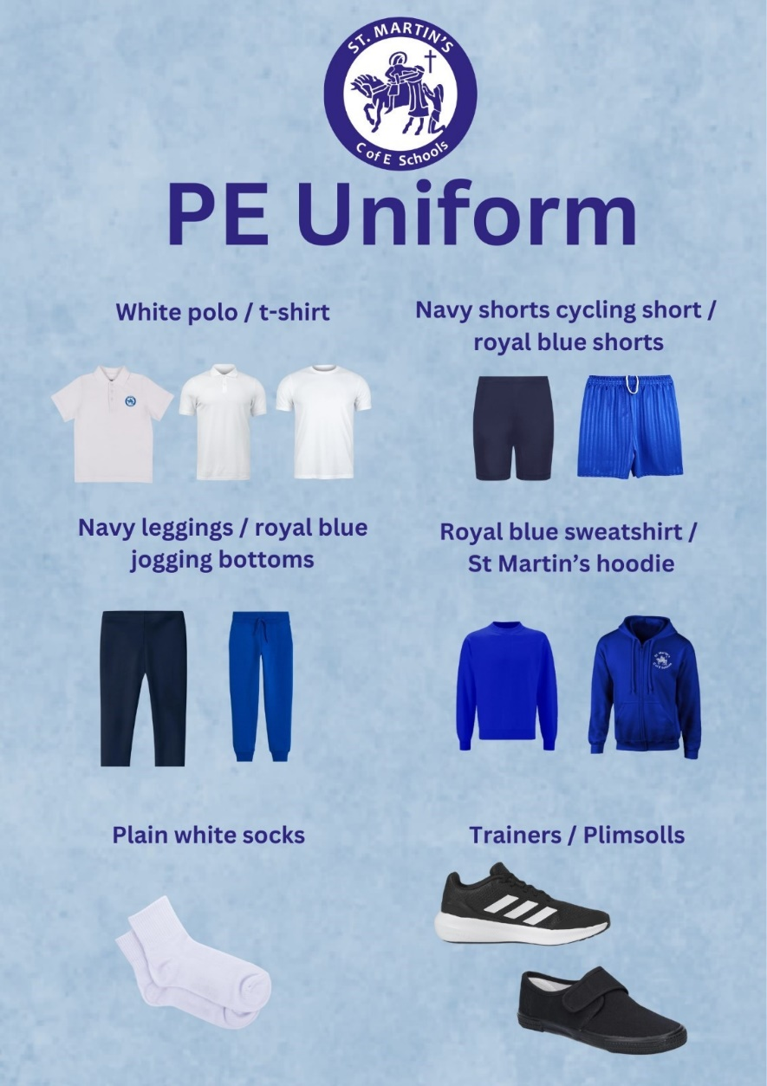
PE
On Wednesday children will have PE sessions. Children will be expected come into school wearing their PE kits and will remain in their kits all day.
Please ensure all PE kits are in in line with the school’s uniform policy.
Notes:
Mel

Slide 9
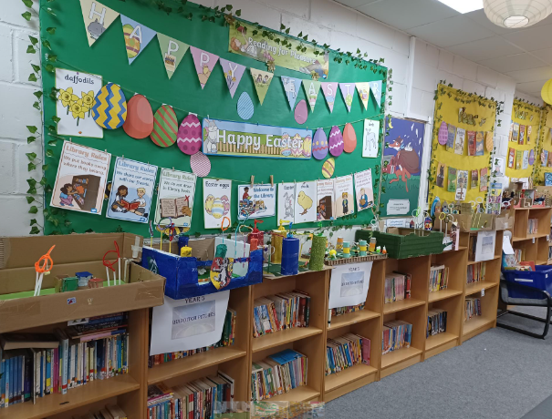
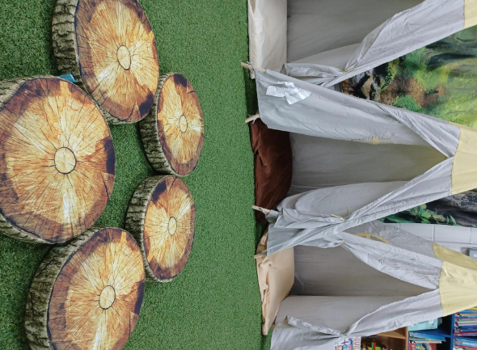
Library
Children will visit the library each week and be able to choose a book to take home. This is an additional book alongside their school reading book to promote a love of reading. We visit the library every FRIDAY afternoon.
Please ensure library books are in book bags every Friday so your child can return and take a new book out.
Notes:
Jax

Slide 10

Curriculum Enrichment
We are passionate about bring the curriculum to life for our children and have some wonderful events to look forward to this year.
Including;
Trip to the British Wildlife Centre
Visits to our local area
Dress up days- Nurses and Soldiers
Theme days
Cricket Coaching sessions
Visitor talks- Illustrator and Epsom Fire Station
Partnership with Year 5
Notes:
Jax

Slide 11

Scientist Day
Do you have a job in the field of science?
We are looking for parents, friends of parents, or relatives, to come into school and talk a little about their career in science.
Our Aim:
We want our children to be inspired and amazed by the vast number of jobs available and accessible to them.
PLEASE fill in the volunteer contact sheet and Mrs Williams will be in touch.
Notes:
Madi

Slide 12

Birthdays
Over the course of the year if you wish to celebrate your child’s birthday please refrain from bringing in sweets or treats for the class. Instead, we suggest a class book donation.
Notes:
Jax

Slide 13



Celebrating Great Learning
Each week we will choose a Values Award winner a Star of the Week and Superstar of the Week who can choose a prize e.g. bring in a teddy for the day, hot chocolate, non- uniform day.
At the end of each term, class teacher will also award a Book Prize for one individual who has shown great progress, improvement or consistency that term.
Notes:
Madi

Slide 14
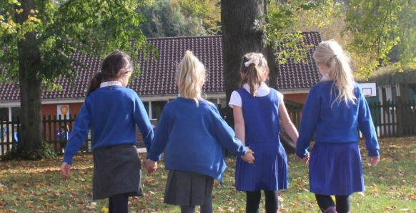
Open Mornings and Afternoon
Open mornings/afternoons enable parents and carers to come into school and look through your child’s books.
They are scheduled every term, on different days and times to enable parents and carers to make necessary provisions and attend.
Parent consultations will also take place before half term.
Notes:
Madi

Slide 15
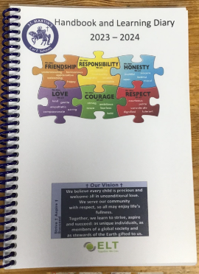
Learning Diary
The Learning Diary is a way of communicating between home and school. Every Friday we will place weekly learning sticker with important notices for the upcoming week.
In the diaries, we will also record when the children have read at school and you should record when you have read with your child at home. Children will read with an adult each week.
There is also a wealth of useful information, phonics support, term dates and a e-safety contract.
Please ensure that the learning diary is inside your child’s
bookbag daily, along with your child’s school reading book.
Notes:
Mel

Slide 16
Home Learning
Ways you can support your child’s learning at home:
Reading at home at least four times a week
Complete weekly home learning task in ‘Home Learning Books’- books are not to be decorated
Weekly spelling test practice (children will be tested)
Focus common exception words and topic word of the week
Numbots and Spelling Shed Games
Notes:
MEl

Slide 17
Reading at home
Please do remember each school-book should be read three times once to develop decoding skill, the second time to build up fluency and reading with expression, last for comprehension.
Comprehension needs to be a priority as children become increasing confident readers.
Notes:
Mel

Slide 18
GPS and Handwriting
Children will have GPS (Grammar, Punctuation and Spelling) sessions with targeted spelling and daily phonics sessions. Children who did not pass the phonics check will continue to receive additional weekly phonics interventions and will be re-tested each half term.
In Year 2, our emphasis is on joined up writing. The children will have weekly handwriting lessons and will have a letter to practise as part of their home learning.
Notes:
JAx

Slide 19
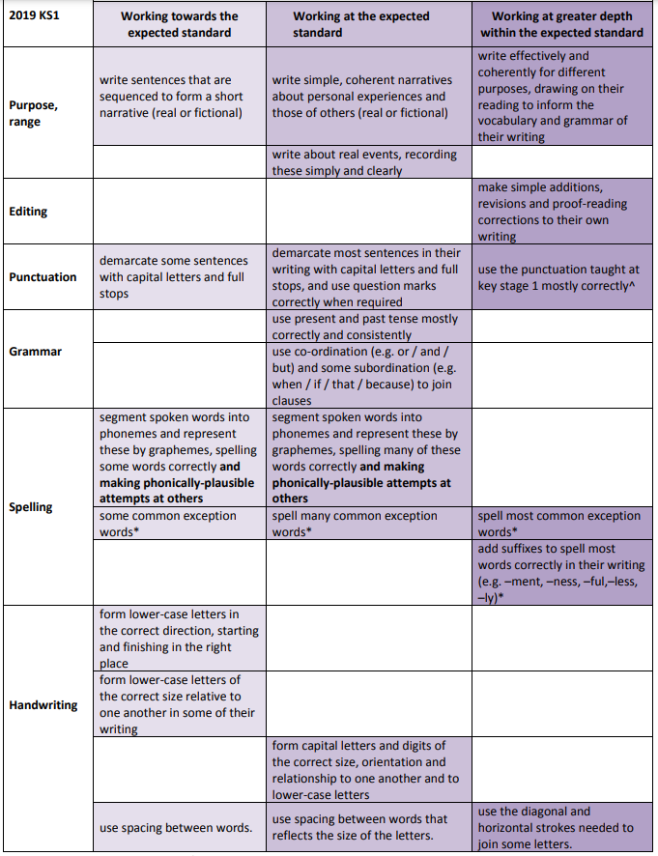
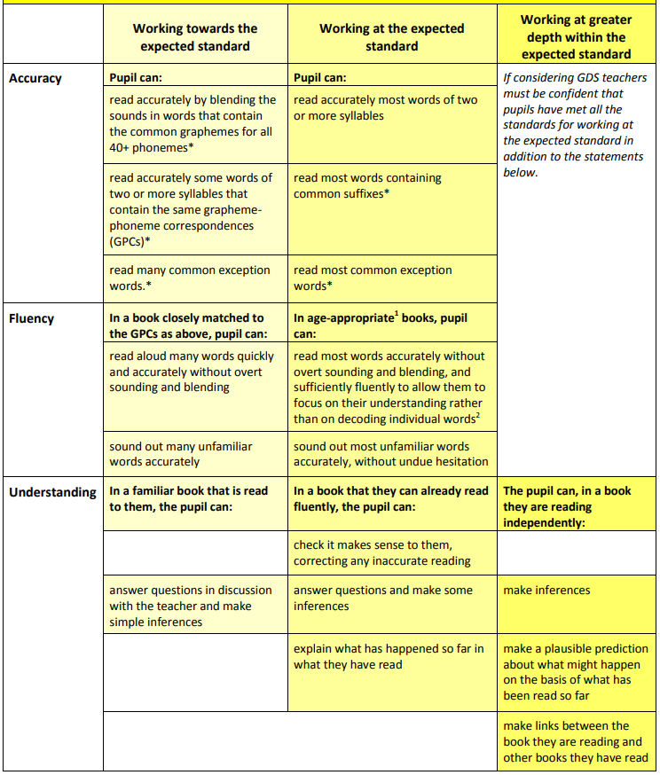
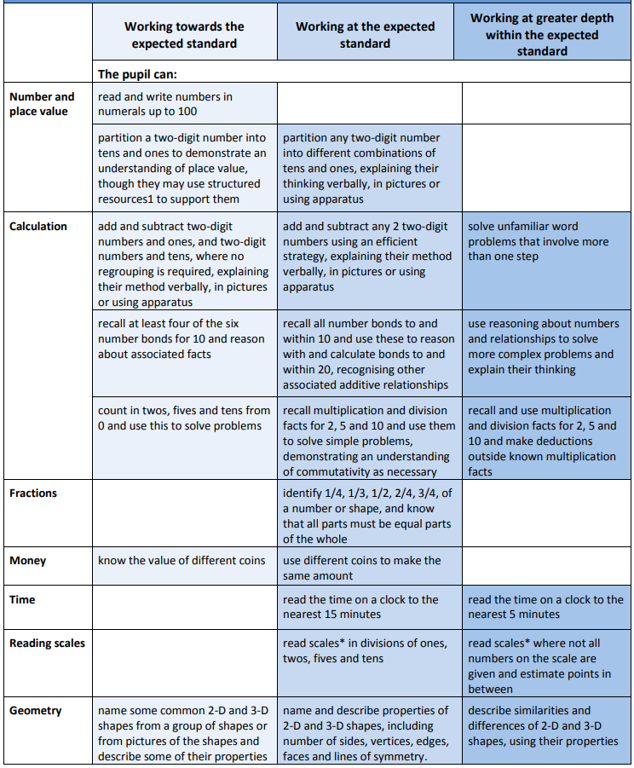
End of Year Expectations
Framework that children are assessed on at the end of the year in writing, reading and maths. At the parent consultation meeting we will share a copy.
Notes:
Jax

Slide 20
Communication
Please do keep up to date with key year group and school events and information via the weekly newsletter. As well as lots of useful information on the school’s website.
We have the year group email address year2@stmartinsepsom.school
If you are reporting a child absence that should be emailed to the school office email address
office@stmartinsepsom.school
Notes:
Madi

Slide 21
Thank You
We hope you have found this information helpful we look forward to an exciting year.
If you have any further questions please do not hesitate to ask.
Notes:
Mel

