Slide 1
My turn your turn

Slide 2

the

Slide 3

I

Slide 4

put

Slide 5

no

Slide 6

a

Slide 7

my

Slide 8

is

Slide 9

for

Slide 10

he

Slide 11

your

Slide 12

said

Slide 13

she

Slide 14

you

Slide 15

be

Slide 16

want

Slide 17

are

Slide 18

to

Slide 19

baby

Slide 20

me

Slide 21

her

Slide 22

when

Slide 23
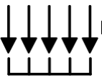
all

Slide 24

of

Slide 25

some

Slide 26
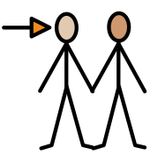
they

Slide 27

do

Slide 28
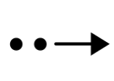
so

Slide 29

was

Slide 30

what

Slide 31

go

Slide 32

mum

Slide 33

dad

Slide 34

old

Slide 35
Have a go on your own!

Slide 36
the

Slide 37
I

Slide 38
put

Slide 39
no

Slide 40
a

Slide 41
my

Slide 42
is

Slide 43
for

Slide 44
he

Slide 45
your

Slide 46
said

Slide 47
she

Slide 48
you

Slide 49
be

Slide 50
want

Slide 51
are

Slide 52
to

Slide 53
baby

Slide 54
me

Slide 55
her

Slide 56
when

Slide 57
all

Slide 58
of

Slide 59
some

Slide 60
they

Slide 61
do

Slide 62
so

Slide 63
was

Slide 64
what

Slide 65
go

Slide 66
mum

Slide 67
dad

Slide 68
old

Slide 69
so

Slide 70
Some red word ideas to practice at home.
Write out each red word x amount of times,
Write the red words in different colours/ different sizes,
Write a red word in a sentence,
Spot the red word in the sentence,
Make up your own sentence including a red word,
Go on a red word hunt,
Write the red words on post it notes and stick around the house,
Play snap with red word cards,
Play I spy using the red words.

